Slide 1
Belonging
An introduction

Slide 2
What do you belong to?

Slide 3
What do you belong to?
Family
Social group
Planet
Country
Town
School
Club
Job
Experiences

Slide 4
How do we study Belonging?
AREA OF STUDY
In the Area of Study, students explore and examine relationships between language and text, and interrelationships among texts. They examine closely the individual qualities of texts while considering the texts’ relationships to the wider context of the Area of Study.
They synthesise ideas to clarify meaning and develop new meanings. They take into account whether aspects such as context, purpose and register, text structures, stylistic features, grammatical features and vocabulary are appropriate to the particular text.
English Stage 6 Syllabus (1999) Board of Studies NSW, Sydney

Slide 5
How do we study Belonging?
AREA OF STUDY: Belonging
This Area of Study requires students to explore the ways in which the concept of belonging is represented in and through texts.
Perceptions and ideas of belonging, or of not belonging, vary. These perceptions are shaped within personal, cultural, historical and social contexts. A sense of belonging can emerge from the connections made with people, places, groups, communities and the larger world. Within this Area of Study, students may consider aspects of belonging in terms of experiences and notions of identity, relationships, acceptance and understanding.

Slide 6
How do we study Belonging?
Texts explore many aspects of belonging, including the potential of the individual to enrich or challenge a community or group. They may reflect the way attitudes to belonging are modified over time. Texts may also represent choices not to belong, or barriers which prevent belonging.
Perceptions and ideas of belonging in texts can be constructed through a variety of language modes, forms, features and structures. In engaging with the text, a responder may experience and understand the possibilities presented by a sense of belonging to, or exclusion from the text and the world it represents. This engagement may be influenced by the different ways perspectives are given voice in or are absent from a text.

Slide 7
How do we study Belonging?
In their responses and compositions students examine, question, and reflect and speculate on:
how the concept of belonging is conveyed through the representations of people, relationships, ideas, places, events, and societies that they encounter in the prescribed text and texts of their own choosing related to the Area of Study
assumptions underlying various representations of the concept of belonging
how the composer’s choice of language modes, forms, features and structures shapes and is shaped by a sense of belonging

Slide 8
WHAT????

Slide 9
WHAT THE HELL DOES THAT MEAN???
Basically that means:
What does the text say about the concept of Belonging?
How is that idea put across?
&

Slide 10
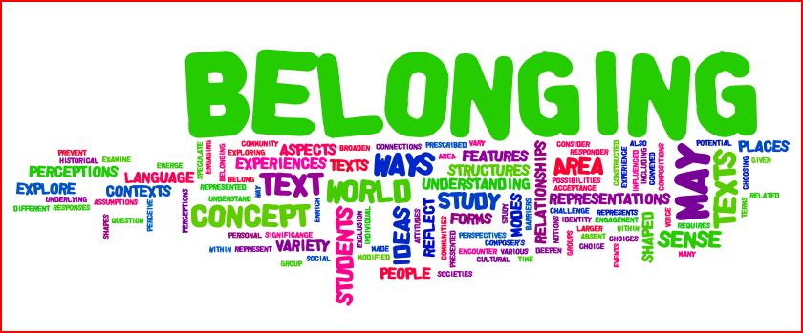
Key words from the Rubric

Slide 11
Your Own Belonging Mindmap
Wider World
People/ Relationships
Places
Groups/ Communities

Slide 12
My Own Belonging Mindmap
Wider World
Australian
People/ Relationships
Levy/Mooney
Places
Groups/ Communities
Farrer
Backpacker
GF
Friend
Female
Caucasian
Catholic background
Jewish Name
Tamworth
UNSW
Baxter College
Theatre
ETA
South Untied Football Club / Avalon Soccer Club
The Flames Basketball Team
Left Wing
Sydney
Oxley High/Barrenjoey High
Laurieton
Beach
Melbourne
London
Henry

Slide 13
The words we choose for Belonging
Relationship | Alienation | The Black Sheep
Affinity | Isolation | The Deviant
Acceptance | Disconnected | The Drifter
Fellowship | Estrangement | The Misfit
Association | Outcast | The Outsider
Loyalty | Divorce | The Pariah
Attachment | Withdrawal | The Rebel
Inclusion | Separation | The Whistleblower
Rapport | Remoteness
Affiliation | Indifference | Out-of-the-way
Kinship | Disaffection | In the Middle of Nowhere
Togetherness | Loneliness
Closeness | Exile | Issues of Citizenship
Membership | Insularity | Issues of Identity
Community | Segregation
Solidarity | Distant | Belonging to the text
Family | Otherness | Exclusion from the text
Understanding | Displacement
Conformity | Exclusion
 | Rejection
 | Marginality
http://www.insidebreak.org.au/belonging/

Slide 14
The Tension
Find the point where the tension arises
between
&
Belonging
Alienation

Slide 15
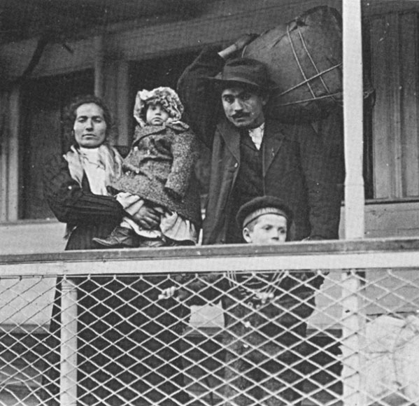
Immigrants
http://www.latinamericanstudies.org/immigration/italian-immigrants-1.jpg

Slide 16
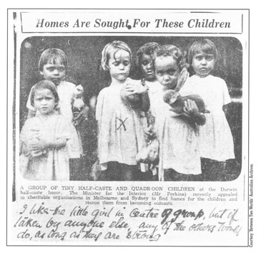
The Stolen Generation
http://www.creativespirits.info/aboriginalculture/politics/stolen-generations-abuse.html
A group of tiny half-caste and quadroon children at the Darwin half-caste house. The Ministry for the Interior (Mr Perkins) recently appealed to charitable organisations in Melbourne and Sydney to find homes for the children and rescue them from becoming outcasts.
I like the little girl in the centre of group, but if taken by anyone else, any of the others would do as long as they are strong.

Slide 17
Fans
http://resources0.news.com.au/images/2011/08/31/1226126/425428-all-blacks-fans.jpg

Slide 18
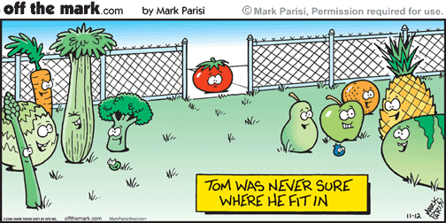
Philosophical dilemmas
http://www.offthemarkcartoons.com/cartoons/2006-11-12.gif

Slide 19
Umbrella Statements
As we go – you need to be collating the CONCEPTS of Belonging –
STATEMENTS that encapsulate an aspect of belonging that is portrayed within a text

